Slide 1
Abstract and learning objectives
Abstract
This whiteboard design session will guide us through designing an end-to-end solution for e-commerce that is based on Azure App Services, Azure Active Directory, and Azure Serverless. We must ensure the solution is PCI-compliant, and that appropriate security measures are put into place for both on-premises and public access scenarios.
Learning objectives
Deploying and configuring Azure Web Apps
Configuring web apps for authentication with Azure AD and Azure AD B2C
Instrumenting and load-testing applications with App Insights
Automating back-end services using Azure Functions and Logic Apps
Notes:
This is an introduction to the Cloud Workshop at a high level. Later we’ll get into customer objections, requirements, etc… but we want to ground the participants on the business outcomes we’re going after for the day.

Slide 2
Welcome! Integration with Azure
Peter Cole – App Dev Specialist
Tristan Lymbery – App Dev Specialist
Adam Stephensen – App Dev Specialist
Duncan Taylor – App Dev Specialist
Tae Hwang – Cloud Solutions Architect
Darwin Abustan – Senior Consultant
Ollie Flavel – Senior Architect
Greg Brown – Strategic Account Manager

Slide 3
Welcome to Country
We acknowledge the traditional custodians of the land and their continuing connection to our community. We pay respect to them, their culture and to their elders past and present.

Slide 4
Event Housekeeping
Please turn your phones to silent
Bathrooms are located down the hall
Food is provided for Morning Tea, Lunch, Afternoon Tea (Dietary requirements have been catered for, please respect the needs of these people)
Please be mindful that you are in an office environment and respect those who are working nearby
Please do not enter any meeting rooms other than the event room

Slide 5
Wi-Fi Access
Wi-Fi SSID:
REACTOR SYDNEY
Username:
reactorsydney@Microsoft.com
Password:
Reactor19!

Slide 6
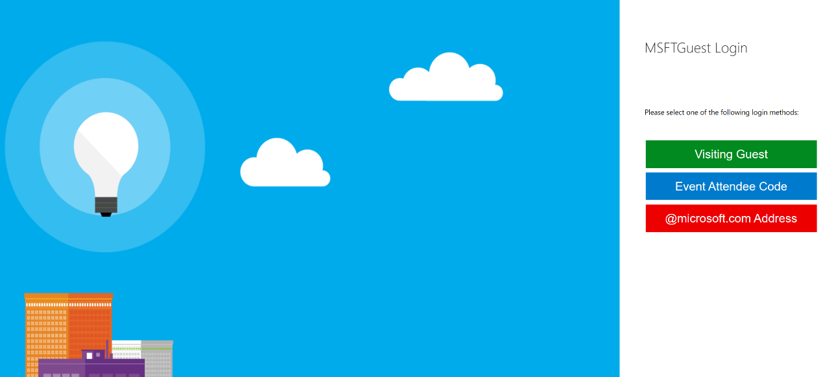
Setting up Wi-Fi Access
Connect to MSFTGUEST Wi-Fi network
A browser window should pop-up with further instructions. If the window does not appear, open a browser window and navigate to the following URL: https://msftguestap.partners.extranet.microsoft.com/guest/msfteventlogin.php?browser=1
Click on Event Attendee Code

Slide 7
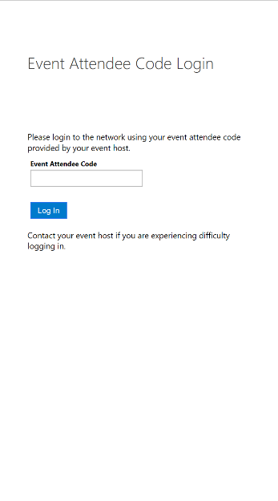
Setting up Wi-Fi Access
Enter the Event Attendee Code
Event Attendee Code:
msevent800en

Slide 8
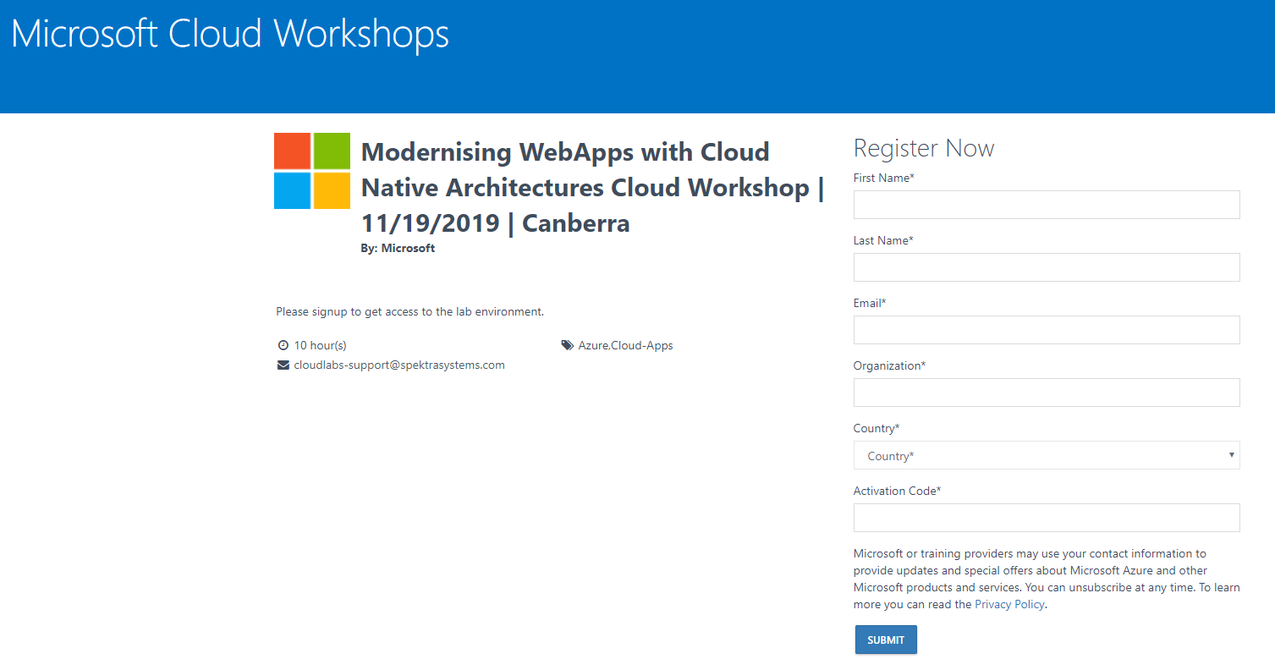
Lab Access
Lab Link:
http://bit.ly/2PCgAHC
Activation Code:
ACTIVATE4666

Slide 9
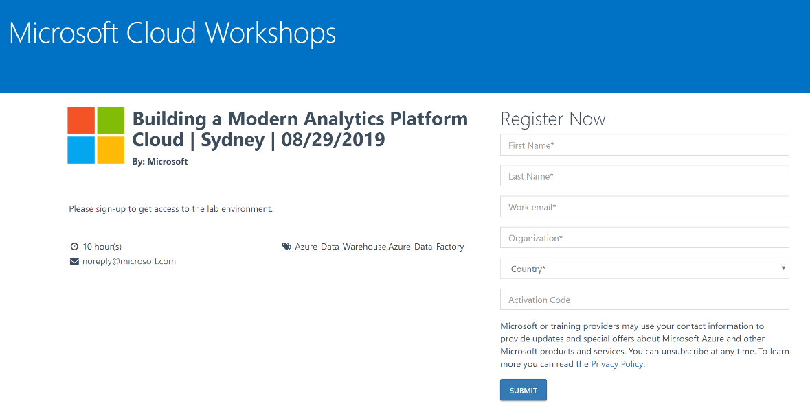
Lab Access
Open a browser window and navigate to the environment sign-up page on the link provided
Enter your details and type in the Activation Code provided
Click Submit
Environment Sign-Up Link:
http://bit.ly/2PCgAHC
Activation Code:
ACTIVATE4666

Slide 10
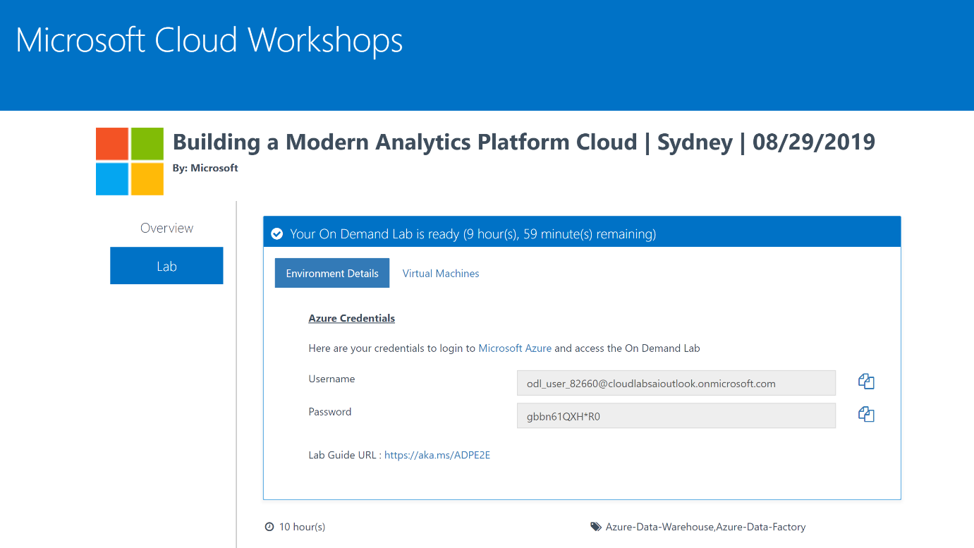
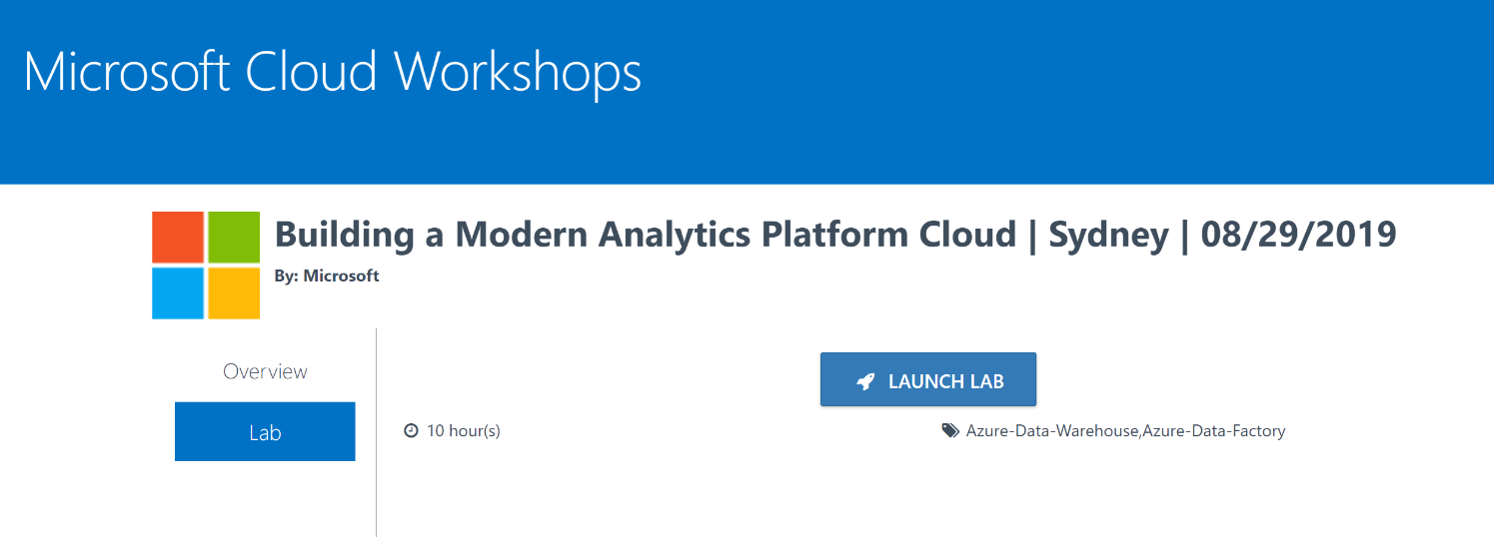
Lab Access
Click LAUNCH LAB
The Environment Details window will appear. Use the Username and Password in this window to access the Azure Portal.
Azure Portal:
https://portal.azure.com/
Lab Guide:
https://aka.ms/MCWMCA

Slide 11
Agenda
 | Duration | Start Time | End Time
Workshop Overview | 15 | 9:00 am | 9:15 am
Integration theory and services | 45 | 9:15 am | 10:00 am
Reviewing the case study | 15 | 10:00 am | 10:15 am
Morning Tea Break | 15 | 10:15 am | 10:30 am
Solution design | 60 | 10:30 am | 11:30 am
Preferred Solution walk through and debrief | 30 | 12:00 am | 12:30 am
Lunch | 30 | 12:30 pm | 1:00 pm
Case study design – asset register | 30 | 1:00 pm | 1:30 pm
Case study design – Logical diagram | 60 | 1:15 pm | 2:15 pm
Afternoon Tea Break | 15 | 2:15 pm | 2:30 pm
Case study design – technical architecture | 70 | 2:30 pm | 3:45 pm
Summarize etc. | 15 | 3:45 pm | 4:00 pm

Slide 12
Agenda
 | Start Time
Workshop Overview | 9:00 am
Intro content and workshop discussion
Morning Tea Break | 10:15 am
Workshop cont.
Lunch | 12:30 pm
Case study
Afternoon Tea Break | 2:15 pm
Case study cont.
Summarize etc.
Finish! | 4:00 pm

Slide 13

What is this?
In this integration workshop, you work with a group to design solutions for integrating different services by leveraging Azure solutions, to meet hypothetical and real business requirements.
Differing to other Microsoft Cloud Workshops, we focus here on design theory around integration scenarios and not so much on copy-paste labs, with the goal of ascertaining a thorough understanding of how to approach integration scenarios.

Slide 14
Icebreaker..
Tables discuss what they want to get out of today
Tables nominate victim to speak to room about what they want

Slide 15
Before we begin…
What is ‘integration’?
What tools are available?

Slide 16
Integration…
Solves a set of common problems:
Stuff needs to be connected
The internet isn’t reliable
Applications are different in what they ask/tell

Slide 17
Integration contains…
Entities:
Messages
Events
“Data”
Entity “handlers”:
Connectors
Routers
‘Bus’
ETL
APIs
Contracts
Etc.
Entities:
Messages
Events
“Data”
and...

Slide 18
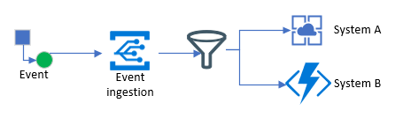
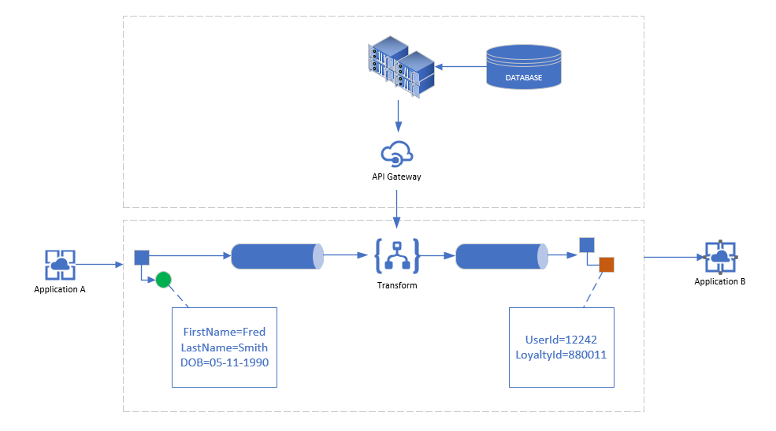
Integration is…a series of patterns
Patterns are modular, discreet solutions which are composed of ‘entities’ and ‘entity handlers’ and fit together, like Lego

Slide 19
Integration is…a series of patterns
What are some common patterns you can think of?
https://aka.ms/workshop-integration-patterns
The book: Enterprise Integration Patterns – Gregor Hohpe and Bobby Wolf

Slide 20
What about Azure Integration Services?...
https://azure.microsoft.com/en-au/product-categories/integration/
https://aka.ms/integration-white-paper

Slide 21
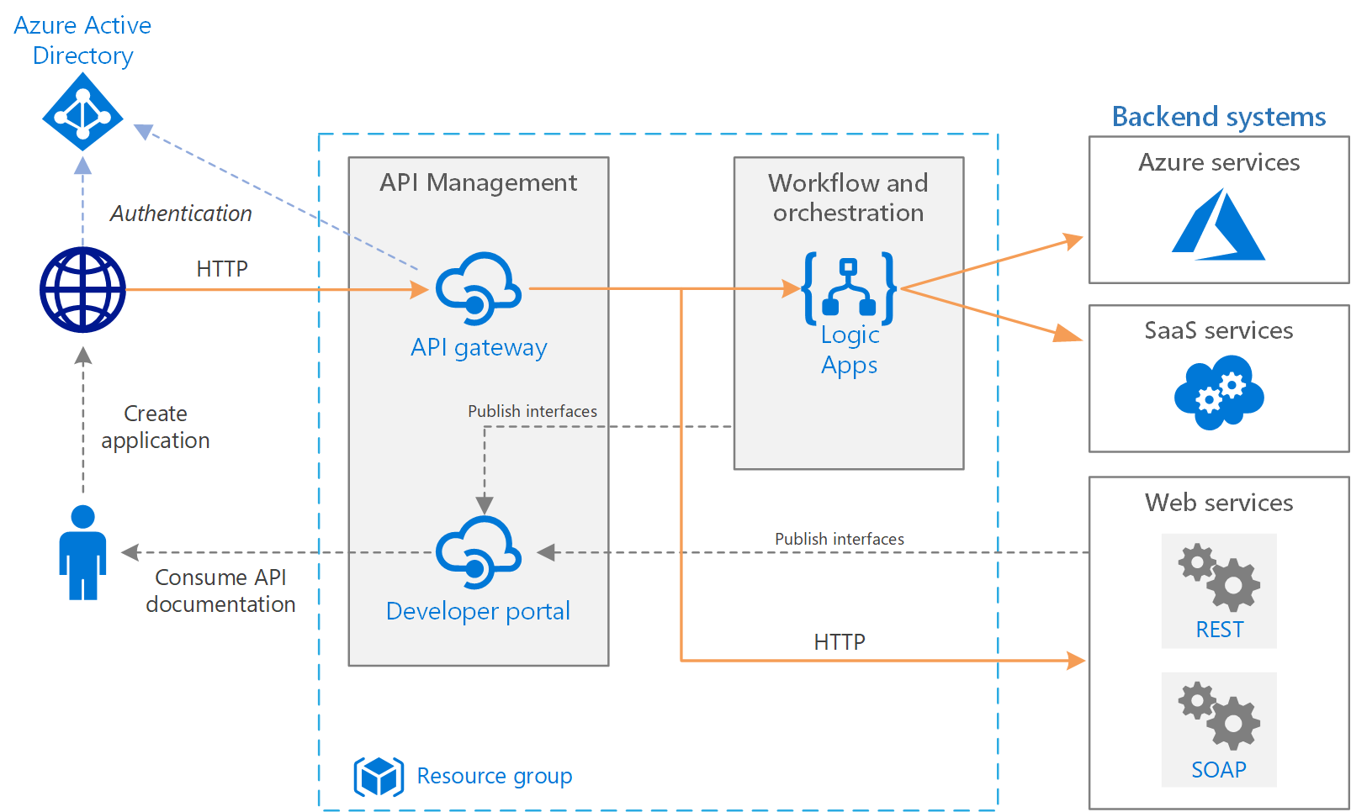
Some reference architectures
https://docs.microsoft.com/en-us/azure/architecture/reference-architectures/enterprise-integration/basic-enterprise-integration

Slide 22
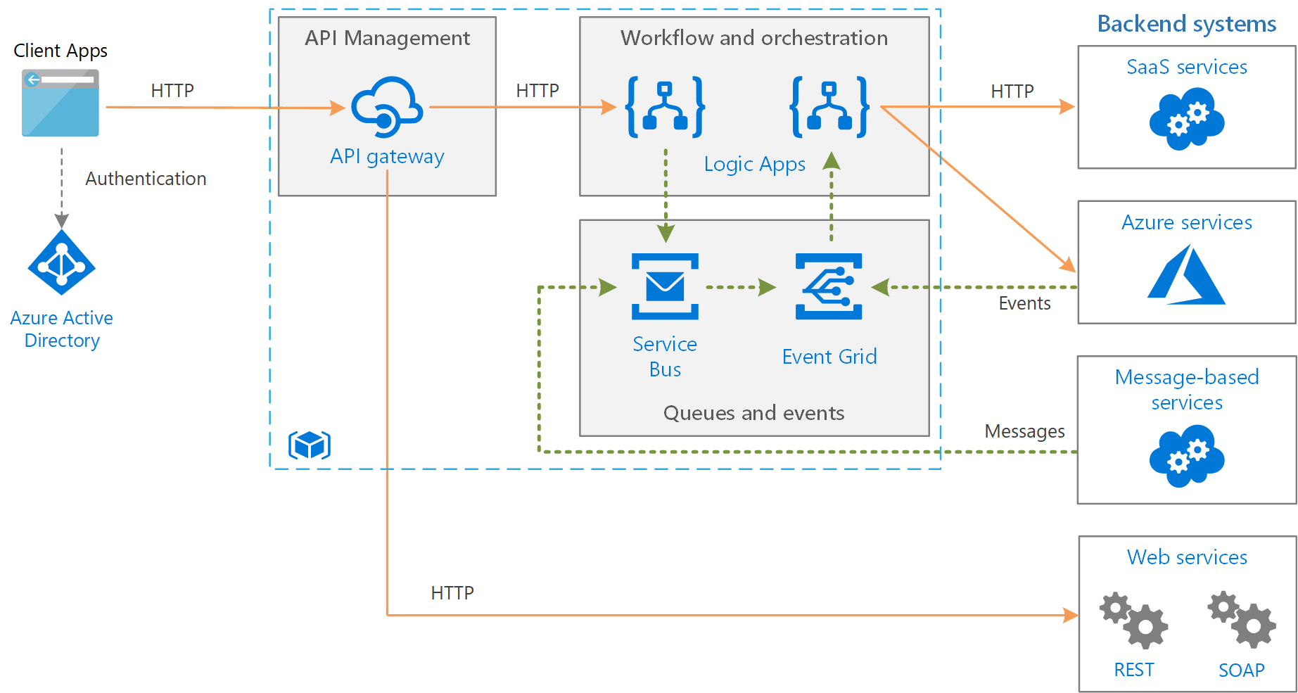
Some reference architectures
https://docs.microsoft.com/en-us/azure/architecture/reference-architectures/enterprise-integration/queues-events

Slide 23
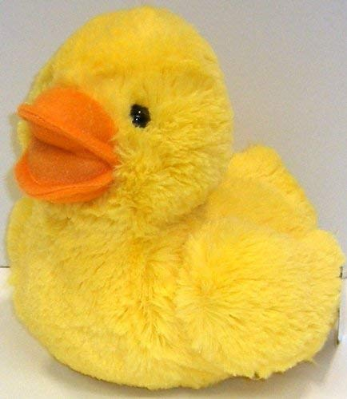
Customer situation
Fluffy Ducks. Co large multi-national organization, which sells plush ducks.
Technology has grown over time due to acquisitions etc.
Have run into several issues with current integration design, and it looking to modernize

Slide 24
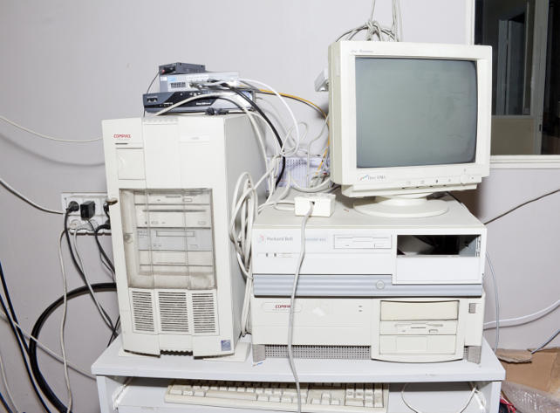
Customer situation
Looking to replace BizTalk, and looking to replace on-prem EOL hardware
Current integration solution doesn’t scale
Integrates with dynamics-365 and a 3rd-party provider
Business has appetite for innovation and redesign of current architecture

Slide 25

Customer needs
Move infrastructure and BizTalk to iPaaS solutions
Ensure local developers aren’t running SSIS packages locally
Migrate most payroll functions to PaaS
Provide a better experience when working with partner organizations (onboarding, data and API exchange, documentation)

Slide 26



Customer objections
How can the system automatically sync and trigger off of events happening?
Can solution provide a seamless partner integration experience for onboarding etc?
Can we secure the platform with an identity platform, such as Azure AD?

Slide 27
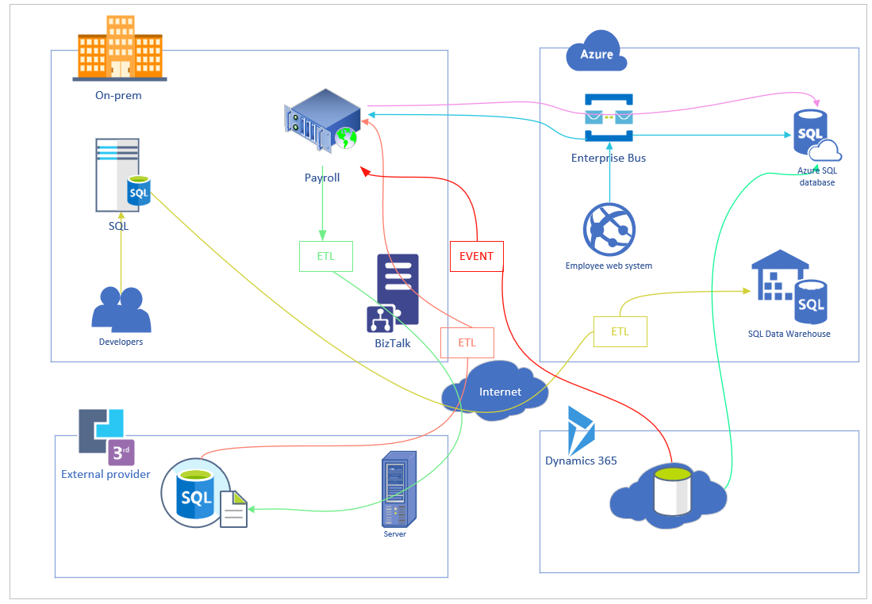
High-level requirements
https://aka.ms/workshop-integration-case-study

Slide 28
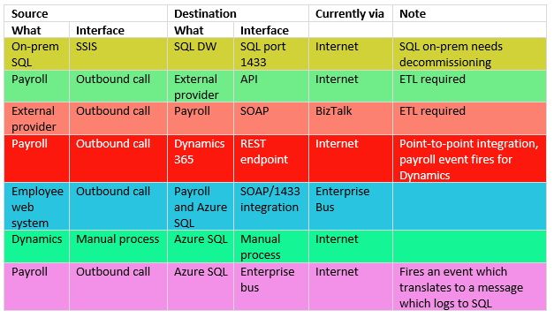
High-level requirements cont.
https://aka.ms/workshop-integration-case-study

Slide 29
Step 1: Review the customer case study
Go to:
https://aka.ms/workshop-integration-case-study
Outcome
Analyze your customer needs.

Slide 30
Step 2: Design the solution
Outcome
Design a solution and prepare to present the solution to the target customer audience in a 15-minute chalk-talk format.
https://aka.ms/workshop-integration-case-study

Slide 31
Step 3: Present the solution
Outcome
Present a solution to the target customer in a 15-minute chalk-talk format
Directions
One table is the Microsoft team and the proctors are the customer.
The Microsoft team presents their proposed solution to the customer.
The customer asks questions about the proposed solution.
The customer team gives feedback to the Microsoft team.
https://aka.ms/workshop-integration-case-study

Slide 32
Wrap-up
What was easy?
What was hard?
What new things did you do or services did you choose?

Slide 33
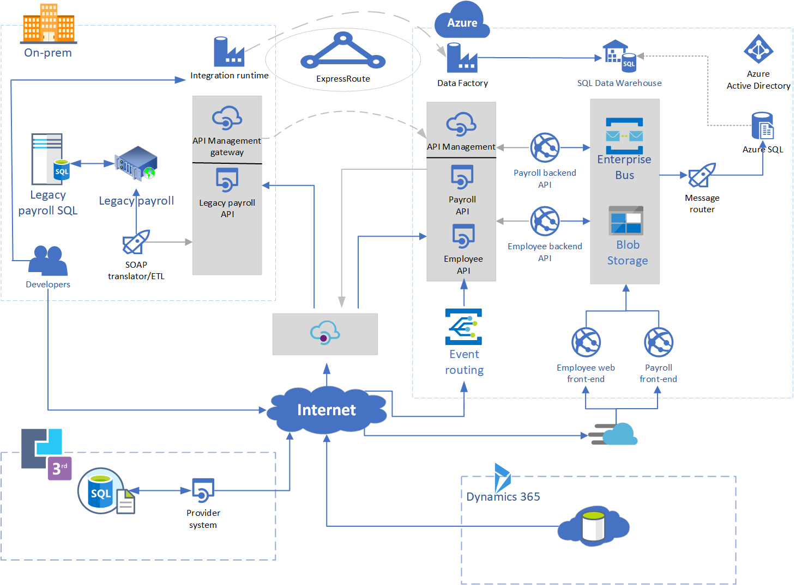
One solution
ABoatwright@bunnings.com.au

Slide 34
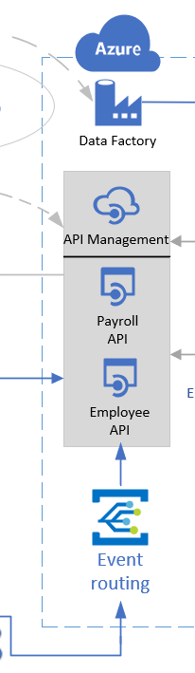
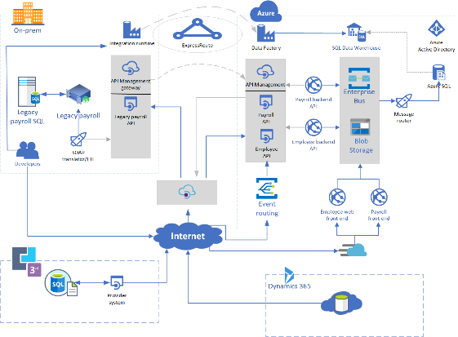
One solution cont.

Slide 35
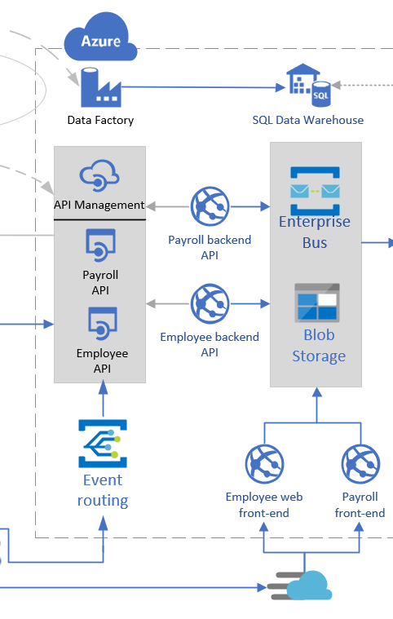
One solution cont.

Slide 36
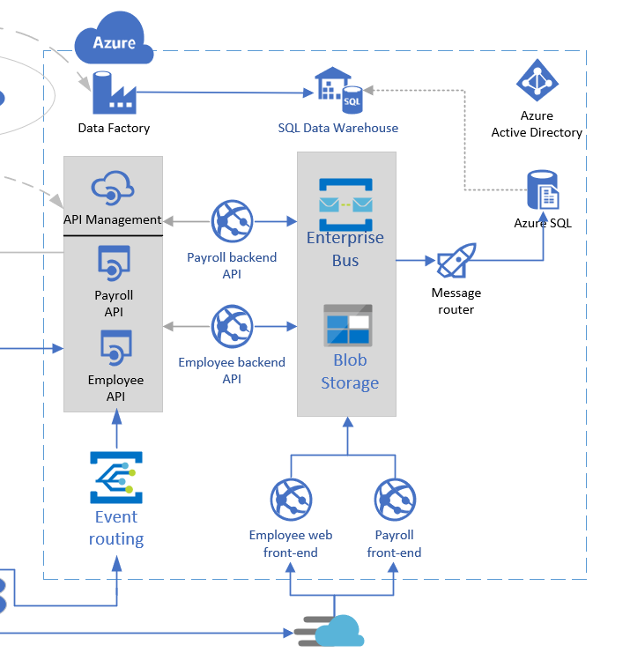
One solution cont.

Slide 37
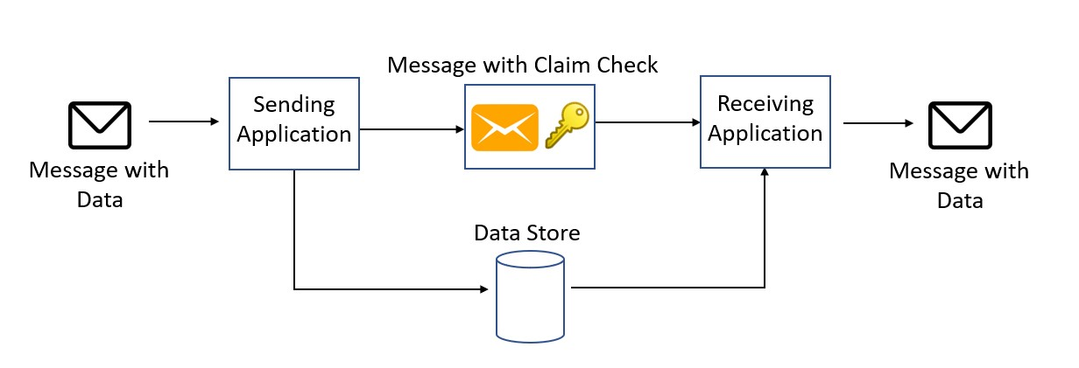
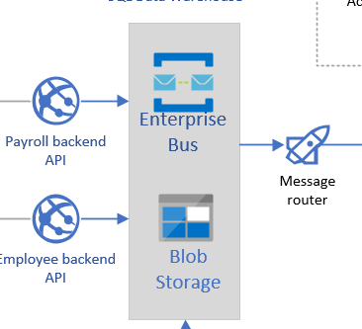
Employee/payroll pattern implemented – claim check

Slide 38
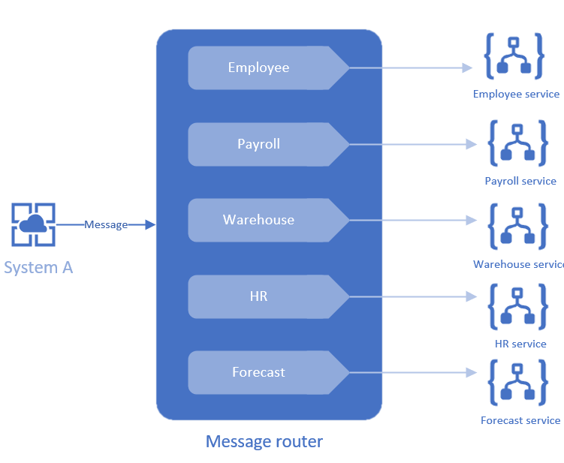
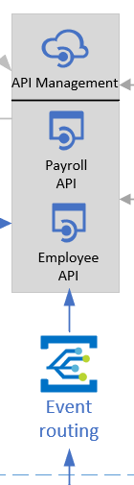
Employee/payroll pattern implemented – message/event router

Slide 39

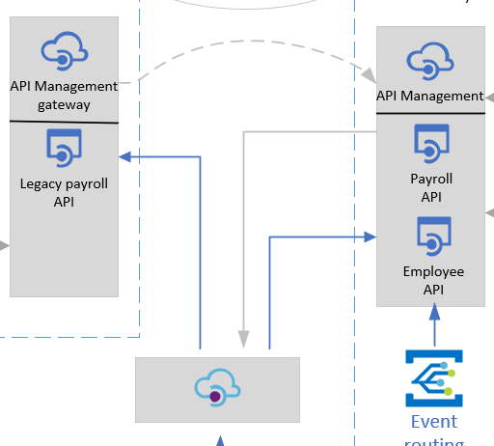
One solution cont.

Slide 40
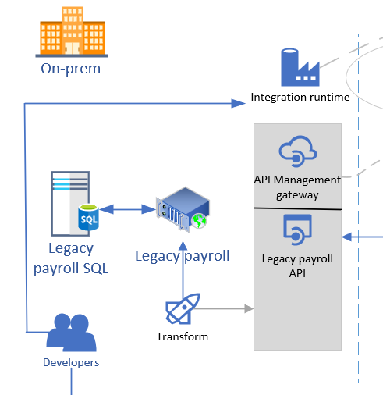
One solution cont.

Slide 41
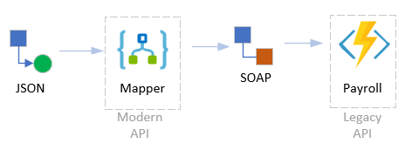
Legacy payroll pattern implemented – mapper

Slide 42
One solution cont.
3rd party provider managed API
Dynamics events into event-grid

Slide 43

One tech choice
Logic Apps
Ability to transform SOAP to other (REST)
Hundreds of connectors to connect to/from most sources
Serverless tech, very hands-off

Slide 44
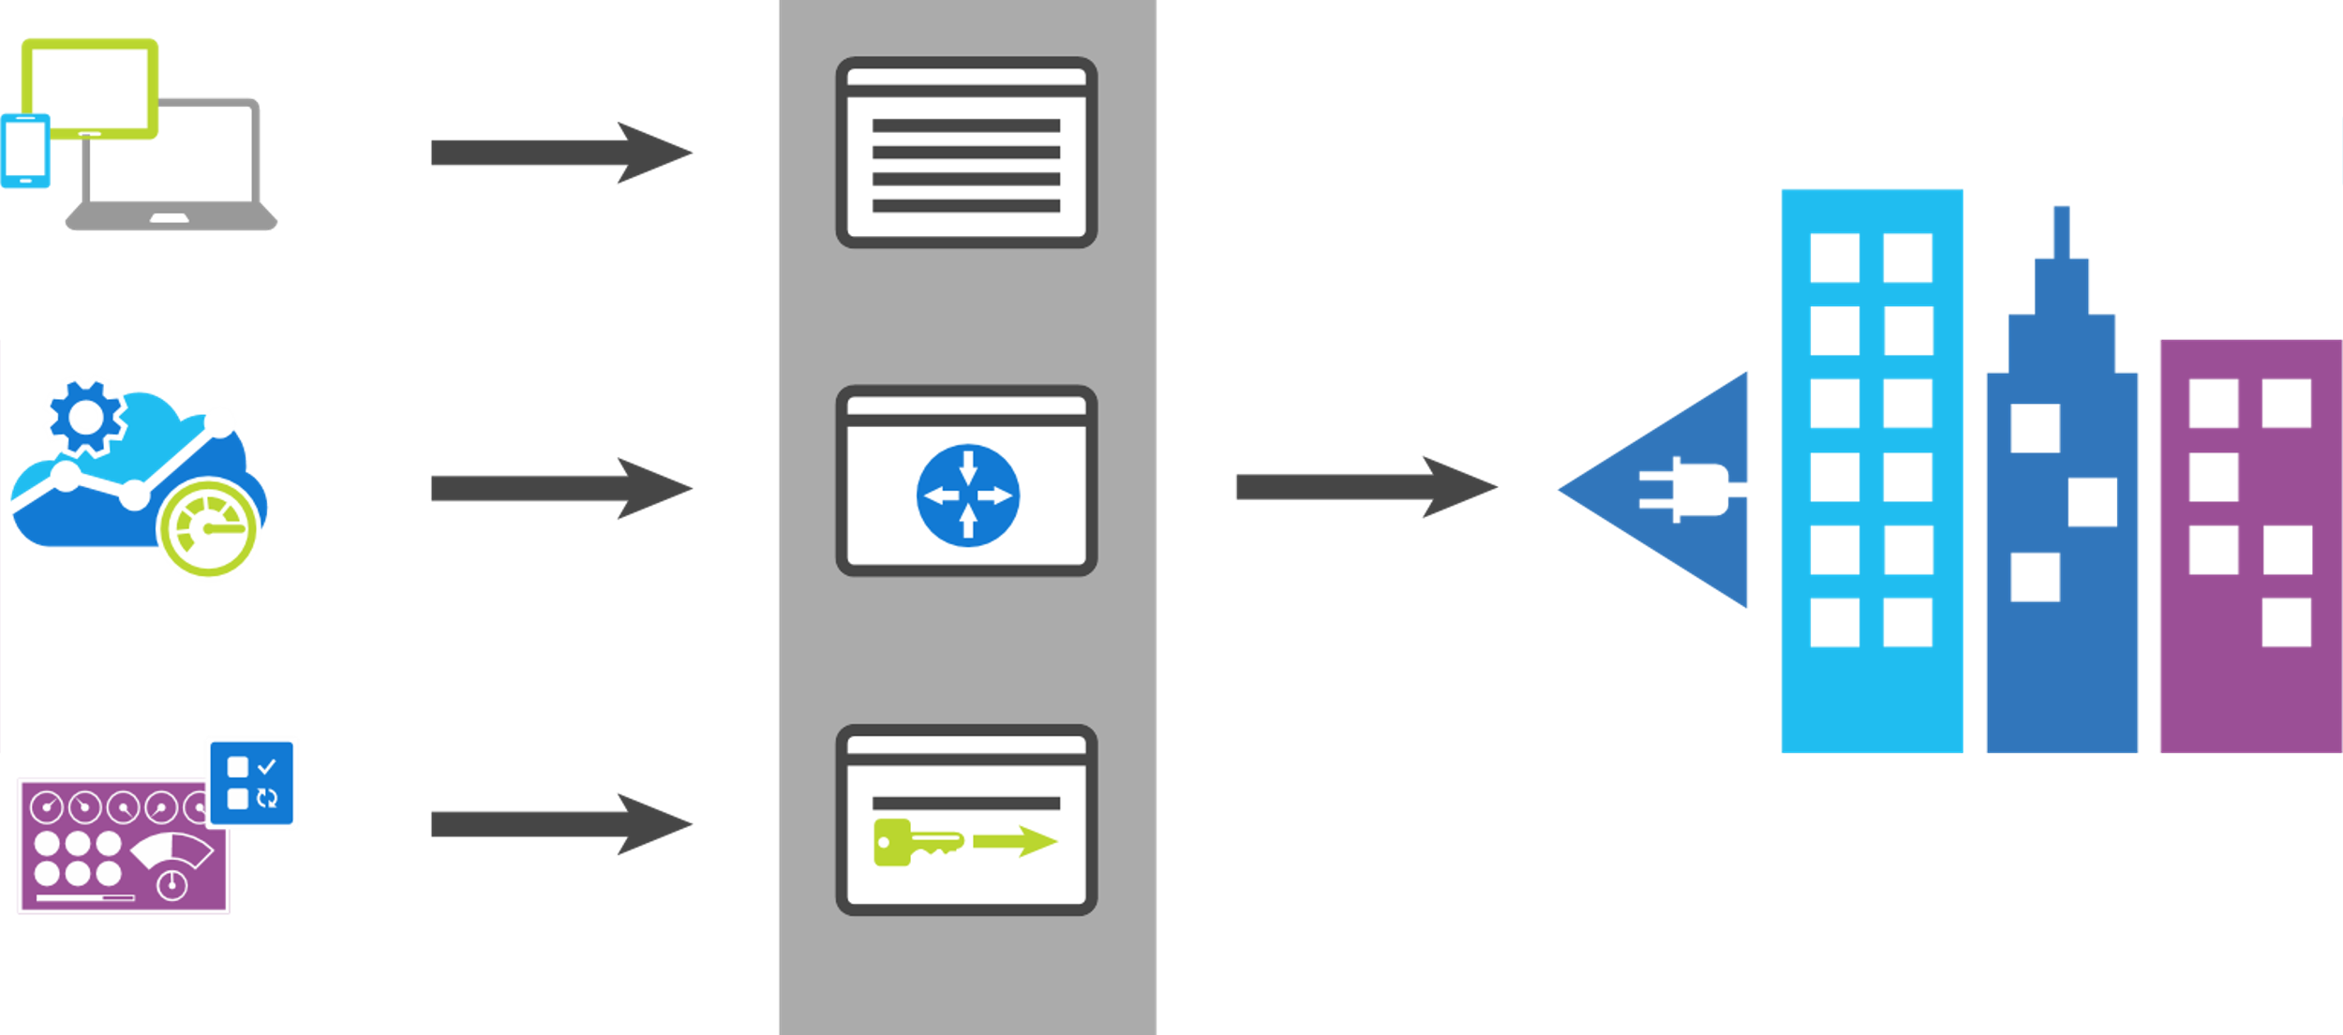
API Management
App developers
Developer portal
Direct to VPN
Apps
Gateway
Backend Services
Apps Publishers
Publisher portal
Notes:
Azure API Management fills all the roles of an API management platform, acting as an API Gateway, a Publisher Portal and a Developer Portal.
The API Gateway is the endpoint that accepts API calls and routes them to your backend services, making the necessary request and response transformations along the way. It’s responsible for enforcing security policies, usage quotas and rate limits, providing optimisations such as caching and for collecting and logging all the metadata on how the APIs are being used for reporting and analysis.
The Publisher Portal is the admin interface where you register and configure your APIs – defining or importing the schemas, packing APIs into products, setting up policies and managing users.
And the Developer Portal acts as the community site for your developers, where they can read API documentation, try out an API via the interactive console, create their account and subscribe to get API keys and access analytics on their own API usage.

Slide 45
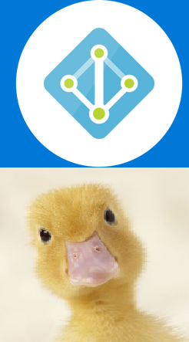
Security
Access control
Use Azure Active Directory
Customize Branding
PIM, conditional access etc.
Apply to any of the services

Slide 46
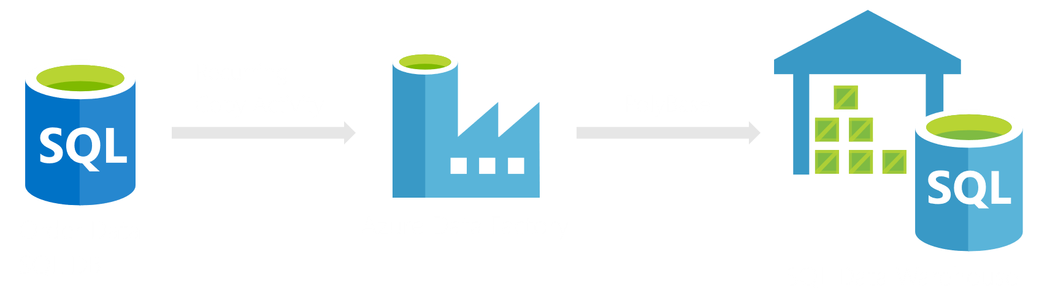
One tech choice
Data Warehouse

Slide 47
Questions?...

Slide 48
Your case study
3 core steps, which must be done in order:
Design an ‘integration asset register’
From the above register, construct the logical diagram of integration flow
From your logical diagram, construct your technical architecture diagram

Slide 49
Your integration asset register – 15 minutes
Use the template below (or something different!). Have a think about patterns to apply:

Slide 50
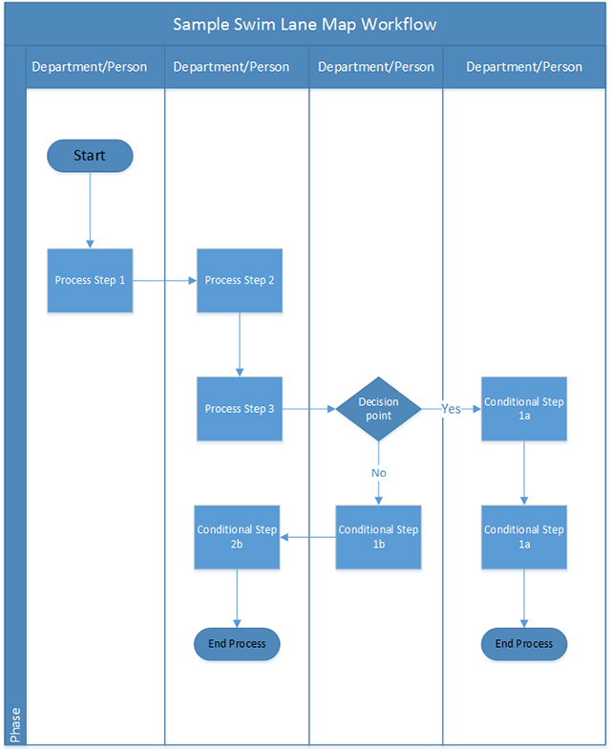
Your integration asset register cont.
Are you using one big biztalk scenario which does 20 different things with all sorts of conditional checks and logic?
Create a swimlane diagram documenting so:

Slide 51
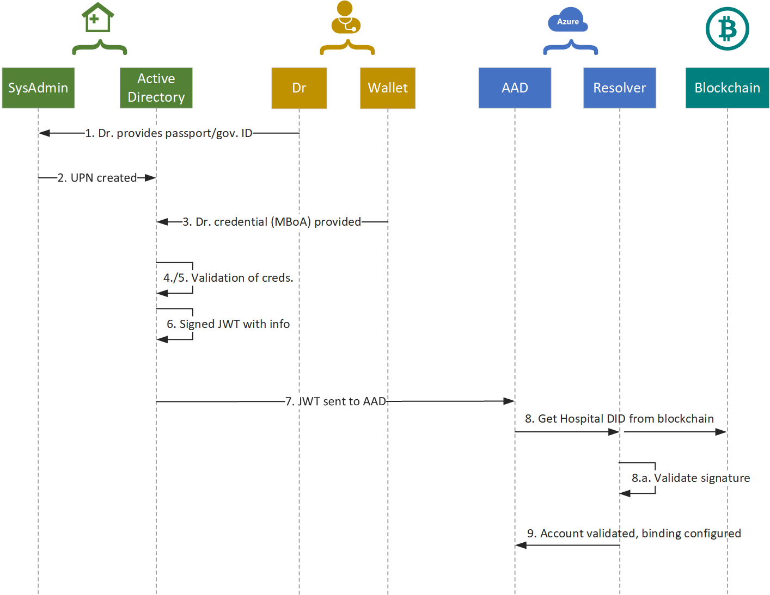
Your integration asset register cont.
Or use this?
Source: www.nlymbery.com.au

Slide 52
Your logical design – 60 minutes (optionalish)
Same as the case-study. It is NOT a technical diagram!

Slide 53
Your technical architecture
Now the fun stuff:

Slide 54
How can Microsoft help?
Azure specialists – Peter
CSA – post-delivery architects providing support
Fasttrack – direct engineering support for qualified project
Next steps: reach out and give Microsoft a call!

Slide 55
How can Insight help?

Slide 56
Thank you!
Feedback: peter.cole@Microsoft.com
Workshop Content:
https://aka.ms/workshop-integration-case-study

